Slide 1
Dijkstra's Algorithm
Delivered by : Mr Zukile Ndyalivana

Slide 2
Shortest Path Problem
Have you ever used Google Maps to find the shortest route or minimum cost of gas to get from one point to another?
If so, then you've encountered an example of the shortest path problem.
In math terms, this is a way to find the shortest possible distance between two vertices on a graph.
Suppose
we're trying to find the shortest path from your house to Divya's house.
We know the distances between various locations throughout town.
If we let various locations be vertices and the routes between them be edges,
we can create a weighted graph representing the situation.
Quick definition: a weighted graph is a collection of vertices and edges with edges having a numerical value (or weight) associated with them.

Slide 3
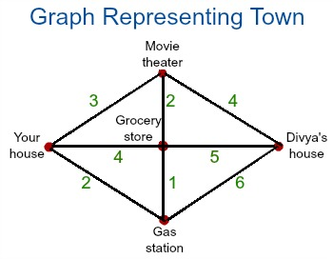

Slide 4
This graph is a great example of a weighted graph using the terms that we just laid out.
There are quite a few different routes we could take, but we want to know which one is the shortest. Thankfully, we've got a nice algorithm that can help us.

Slide 5
Dijkstra's Algorithm
Dijkstra's algorithm is an algorithm we can use to find shortest distances or minimum costs depending on what is represented in a graph.
You're basically working backwards from the end to the beginning, finding the shortest leg each time.
Dijkstra's algorithm makes use of weights of the edges for finding the path that minimizes the total distance (weight) among the source node and all other nodes.
This algorithm is also known as the single-source shortest path algorithm.

Slide 6
Dijkstra’s algorithm is the iterative algorithmic process to provide us with the shortest path from one specific starting node to all other nodes of a graph.
It is different from the minimum spanning tree as the shortest distance among two vertices might not involve all the vertices of the graph.
Note: that Dijkstra’s algorithm is only applicable when all weights are positive because, during the execution, the weights of the edges are added to find the shortest path.

Slide 7
And therefore if any of the weights are introduced to be negative on the edges of the graph, the algorithm would never work properly.
However, some algorithms like the Bellman-Ford Algorithm can be used in such cases.
Generally, Dijkstra’s algorithm works on the principle of relaxation where an approximation of the accurate distance is steadily displaced by more suitable values until the shortest distance is achieved.

Slide 8
The steps to this algorithm are as follows:
Step 1: Start at the ending vertex by marking it with a distance of 0, because it's 0 units from the end.
Call this vertex your current vertex, and put a circle around it indicating as such.

Slide 9
Step 2: #Identify all of the vertices that are connected to the current vertex with an edge.
Calculate their distance to the end by adding the weight of the edge to the mark on the current vertex.
Mark each of the vertices with their corresponding distance, but only change a vertex's mark if it's less than a previous mark.
Each time you mark the starting vertex with a mark, keep track of the path that resulted in that mark.

Slide 10
Step 3: Label the current vertex as visited by putting an X over it. Once a vertex is visited, we won't look at it again.
Step 4: Of the vertices you just marked, find the one with the smallest mark, and make it your current vertex.
Now, you can start again from step 2.

Slide 11
Step 5: Once you've labeled the beginning vertex as visited - stop. The distance of the shortest path is the mark of the starting vertex, and the shortest path is the path that resulted in that mark.
Let's now consider finding the shortest path from your house to Divya's house to illustrate this algorithm.

Slide 12
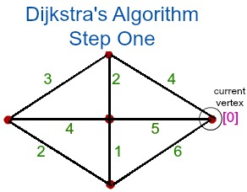
Application
First, we start at the ending vertex (Divya's house).
Mark it with a zero and call this vertex the current vertex, putting a circle around it, as you can see on the graph:

Slide 13
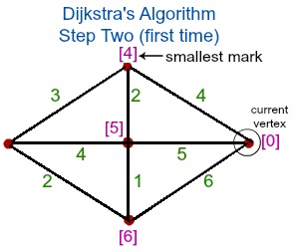
The next step is to mark any vertices that are connected to Divya's house by an edge with the distance from the end.
Let's quickly calculate these distances while we look at a visual representation of what's going on using our previous graph:
Movie theater = 0 + 4 = 4
Grocery store = 0 + 5 = 5
Gas station = 0 + 6 = 6

Slide 14
We're now done with Divya's house, so we label it as visited with an X. We see that the smallest marked vertex is the movie theater with a mark of 4.
This our new current vertex, and we start again at step 2.

Slide 15
More APPLICATIONS of the algorithm
Traffic information systems use Dijkstra‘s algorithm in order to track the source and destina_x0002_tions from a given particular source and destination
In the Link-state routing protocol approach, using Dijkstra‘s algorithm each router calculates
the shortest path to each network and enters this information into the route table.
OSPF- Open Shortest Path First, used in Internet routing. It uses a link-state in the individ_x0002_ual areas that make up the hierarchy. The computation is based on Dijkstra‘s algorithm which is used to calculate the shortest path tree inside each area of the network.

Slide 16
Numerical Algorithm
Formula:
O(|V|^2+|E|=O(V)^2)
WHERE ,
E=Edges and V=Vertices
|E|=Function of edges
|V|=Function of Vertices and
O=Constant

Slide 17
Dijkstra’s works out well as a greedy algorithm
Greedy algorithms work in phases.
In each phase,
a decision is made that appears to be good, without regard for future consequences.
“Take what you can get now”
When the algorithm terminates, we hope that the local optimum is equal to the global optimum.
That’s why Dijkstra’s works out well as a greedy algorithm
It’s greedy
because we assume we have a shortest distance to a vertex before we ever examine all the edges that even lead into that vertex.
It works since all shortest paths contain subpaths that are also shortest paths.
This also works because we assume no negative edge weights.

Slide 18
DISADVANTAGES OF DIJKSTRA‘S ALGORITHM
The major disadvantage of the algorithm is the fact that it does a blind search there by
consuming a lot of time waste of necessary resources.
Another disadvantage is that it cannot handle negative edges. This leads to acyclic graphs and most often cannot obtain the right shortest path.

Slide 19
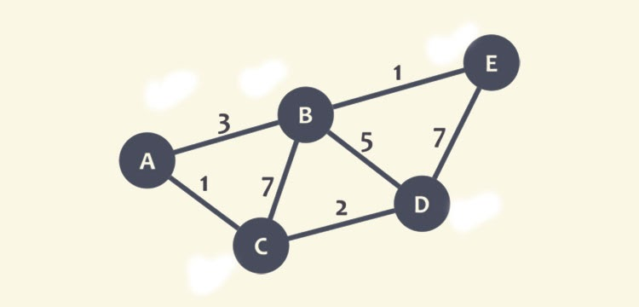
We will calculate the shortest path between node C and the other nodes in the graph.
During the execution of the algorithm, each node will be marked with its minimum distance to node C as we have selected node C.

Slide 20
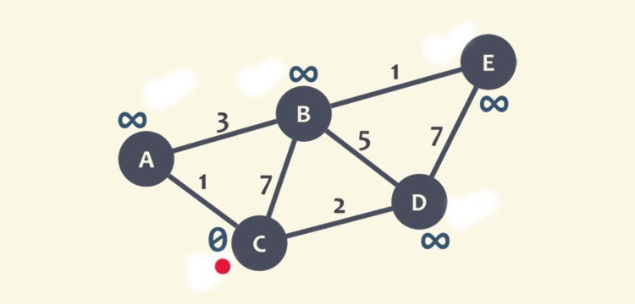
In this case, the minimum distance is 0 for node C. Also, for the rest of the nodes, as we don’t know this distance, they will be marked as infinity (∞), except node C (currently marked as red dot).

Slide 21
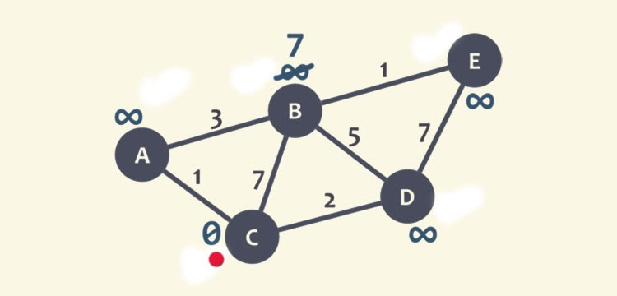
Now the neighbours of node C will be checked, i.e, node A, B, and D. We start with B, here we will add the minimum distance of current node (0) with the weight of the edge (7) that linked the node C to node B and get 0+ 7= 7.
Now, this value will be compared with the minimum distance of B (infinity), the least value is the one that remains the minimum distance of B, like in this case, 7 is less than infinity, and marks the least value to node B.

Slide 22
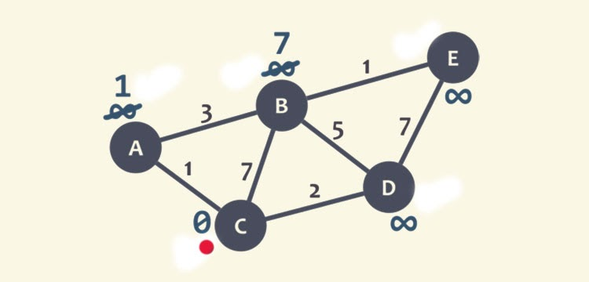
Now, the same process is checked with neighbour A. We add 0 with 1 (weight of edge that connects node C to A), and get 1. Again, 1 is compared with the minimum distance of A (infinity), and marks the lowest value.

Slide 23
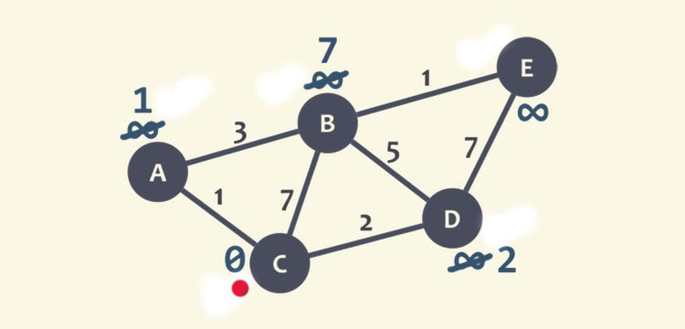
The same is repeated with node D, and marked 2 as lowest value at D.

Slide 24
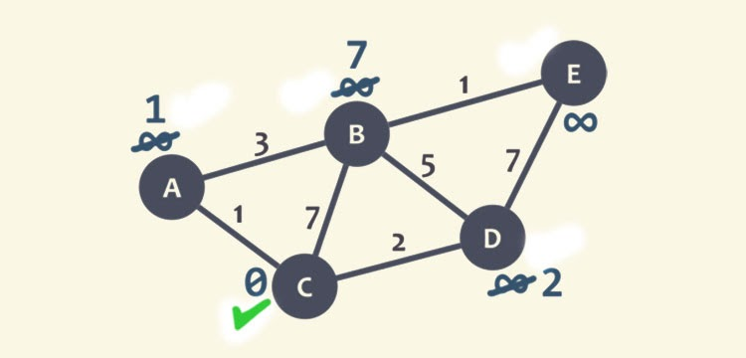
Since, all the neighbours of node C have checked, so node C is marked as visited with a green check mark.

Slide 25
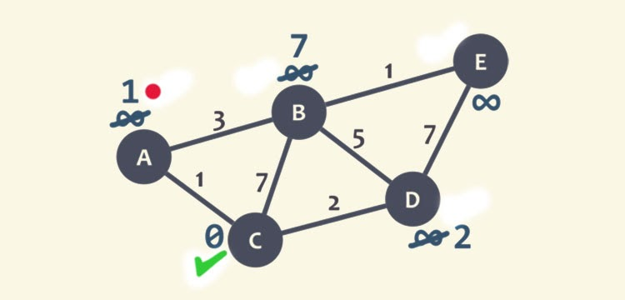
Now, we will select the new current node such that the node must be unvisited with the lowest minimum distance, or the node with the least number and no check mark. Here, node A is the unvisited with minimum distance 1, marked as current node with red dot.

Slide 26
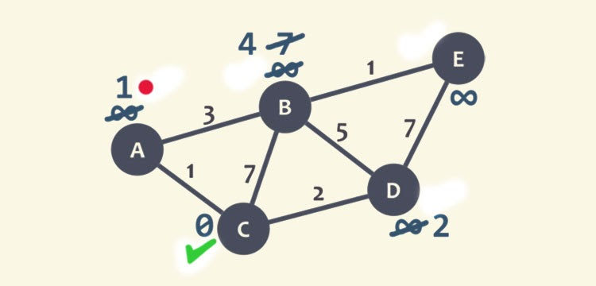
We repeat the algorithm, checking the neighbour of the current node while ignoring the visited node, so only node B will be checked.
For node B, we add 1 with 3 (weight of the edge connecting node A to B) and obtain 4. This value, 4, will be compared with the minimum distance of B, 7, and mark the lowest value at B as 4.

Slide 27
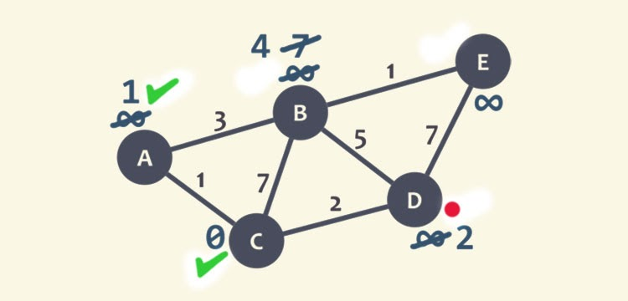
After this, node A marked as visited with a green check mark. The current node is selected as node D, it is unvisited and has a smallest recent distance. We repeat the algorithm and check for node B and E.

Slide 28
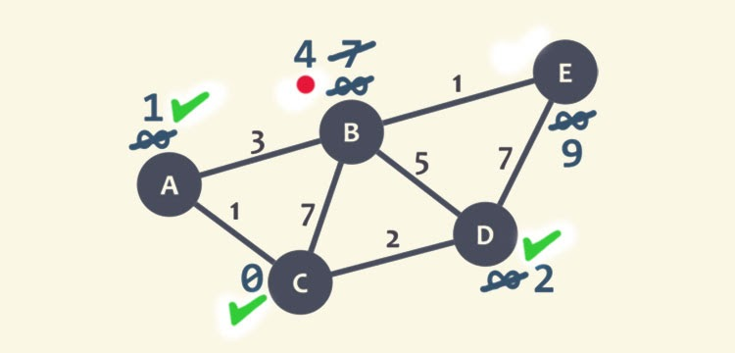
For node B, we add 2 to 5, get 7 and compare it with the minimum distance value of B, since 7>4, so leave the smallest distance value at node B as 4.
For node E, we obtain 2+ 7= 9, and compare it with the minimum distance of E which is infinity, and mark the smallest value as node E as 9. The node D is marked as visited with a green check mark.

Slide 29
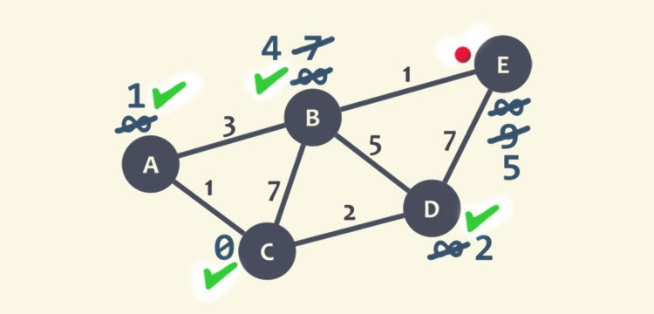
he current node is set as node B, here we need to check only node E as it is unvisited and the node D is visited. We obtain 4+ 1=5, compare it with the minimum distance of the node.
As 9 > 5, leave the smallest value at node node E as 5.
We mark D as visited node with a green check mark, and node E is set as the current node.

Slide 30
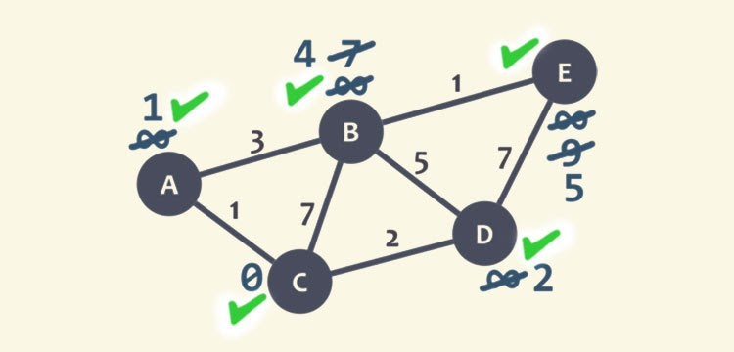
Since it doesn’t have any unvisited neighbours, so there is not any requirement to check anything. Node E is marked as a visited node with a green mark.
So, we are done as no unvisited node is left. The minimum distance of each node is now representing the minimum distance of that node from node C.

Slide 31
Example: Initialization
Distance(source) = 0
0
∞
Distance (all vertices but source) = ∞
A
2
B
4
1
3
10
∞
C
2
D
2
E
∞
5
8
∞
4
6
F
1
G
∞
∞
Pick vertex in List with minimum distance.

Slide 32
Example: Update neighbors' distance
0
2
A
2
B
4
1
3
10
∞
C
2
D
2
E
∞
5
8
1
4
6
Distance(B) = 2
F
1
G
Distance(D) = 1
∞
∞

Slide 33
Example: Remove vertex with minimum distance
0
2
A
2
B
4
1
3
10
∞
C
2
D
2
E
∞
5
8
1
4
6
F
1
G
∞
∞
Pick vertex in List with minimum distance, i.e., D

Slide 34
Example: Update neighbors
0
2
A
2
B
4
1
3
10
3
C
2
D
2
E
3
5
8
1
4
6
Distance(C) = 1 + 2 = 3 Distance(E) = 1 + 2 = 3 Distance(F) = 1 + 8 = 9 Distance(G) = 1 + 4 = 5
F
1
G
9
5

Slide 35
Example: Continued...
Pick vertex in List with minimum distance (B) and update neighbors
0
2
A
2
B
4
1
3
10
3
C
2
D
2
E
3
5
8
1
4
6
Note : distance(D) not updated since D is already known and distance(E) not updated since it is larger than previously computed
F
1
G
9
5

Slide 36
Example: Continued...
Pick vertex List with minimum distance (E) and update neighbors
0
2
A
2
B
4
1
3
10
3
C
2
D
2
E
3
5
8
1
4
6
F
1
G
No updating
9
5

Slide 37
Example: Continued...
Pick vertex List with minimum distance (C) and update neighbors
0
2
A
2
B
4
1
3
10
3
C
2
D
2
E
3
5
8
1
4
6
Distance(F) = 3 + 5 = 8
F
1
G
8
5

Slide 38
Example: Continued...
Pick vertex List with minimum distance (G) and update neighbors
0
2
A
2
B
4
1
3
10
3
C
2
D
2
E
3
5
8
1
4
6
F
1
G
Previous distance
6
5
Distance(F) = min (8, 5+1) = 6

Slide 39
Example (end)
0
2
A
2
B
4
1
3
10
3
C
2
D
2
E
3
5
8
1
4
6
F
1
G
6
5
Pick vertex not in S with lowest cost (F) and update neighbors

